Slide 1




Introduction to Web Development
Attendance
linktr.ee/CODE.CRUNCH

Slide 2
Week #1
Understanding HTML Elements and Attributes

Slide 3
VS Code

Slide 4
GitHub

Slide 5
RECAP

Slide 6
Introduction to HTML
Overview:
Introduction to HTML (Hypertext Markup Language), the foundation of web development.
The role of HTML in structuring the content on a webpage.
Real-World Relevance:
Every website relies on HTML to present text, images, links, and more.
Key foundational technology alongside CSS and JavaScript.
Example: Show example site and explain how HTML builds the structure.

Slide 7
Key Concepts for Today’s Lecture
Concepts Covered:
HTML Elements and Tags
HTML Attributes
Semantic HTML
Accessibility Best Practices
Common HTML Tags (Headings, Paragraphs, Links, Lists, Images)

Slide 8
What is HTML?
HTML Definition: HTML is a markup language used to structure content on the web.
Structure of an HTML document:
Document Type Declaration (DOCTYPE) – Specifies the HTML version (e.g., HTML5).
HTML Element – The root element of the document.
Head and Body – Where metadata and content reside.
Example: A simple HTML document structure.

Slide 9
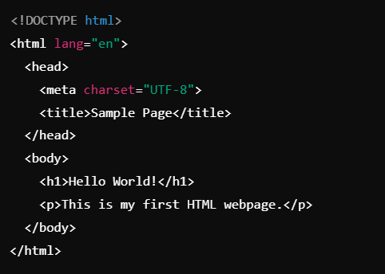

Slide 10
Lesson

Slide 11

HTML Elements and Tags
What is an HTML Element?
An HTML element is a building block of HTML. It consists of an opening tag, content, and a closing tag.
Structure: <tagname>content</tagname>
Example: <h1>Hello World!</h1>
Visual: Break down the tag <h1> into <, h1, >, content, </h1>.

Slide 12
HTML Attributes
What are HTML Attributes?
Attributes provide additional information about an element.
They are added o the opening tag and consist of a name and a value.
Common HTML Attributes:
href, src, alt, class, id, style
Examples:
Anchor Tag: <a href="https://www.example.com">Click here</a>
Image Tag: <img src="image.jpg" alt="A sample image">

Slide 13
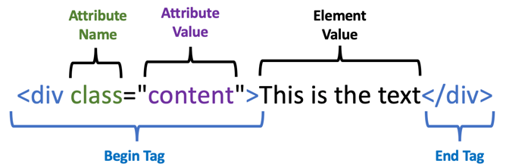

Slide 14
Semantic HTML
What is Semantic HTML?
Semantic HTML uses elements that convey meaning about the content they contain (rather than just for styling purposes).
Why it's important:
Improves accessibility for screen readers.
Enhances SEO (Search Engine Optimization).
Makes the code easier to read and maintain.
Examples of Semantic Tags:
<header>, <footer>, <article>, <section>, <nav>

Slide 15
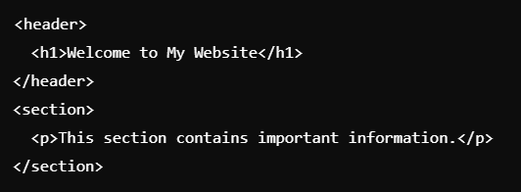

Slide 16
Accessibility Best Practices
Why is Accessibility Important?
Accessibility ensures that all users, including those with disabilities, can navigate and interact with the website.
Best Practices:
Use semantic HTML to help screen readers interpret the content.
Provide alt text for images: <img src="image.jpg" alt="Description of image">
Ensure good color contrast for readability.
Use headings (<h1>, <h2>, etc.) in a logical order to provide structure.
Real-World Example: Show a webpage with and without alt text on images.

Slide 17
Common HTML Tags
Headings: <h1> to <h6> tags for creating headings of different levels.
Paragraphs: <p> tag to define paragraphs of text.
Links: <a href="url">link text</a> to create hyperlinks.
Lists: Unordered (<ul>) and ordered (<ol>) lists with list items (<li>).
Images: <img src="image.jpg" alt="Description"> to add images.

Slide 18
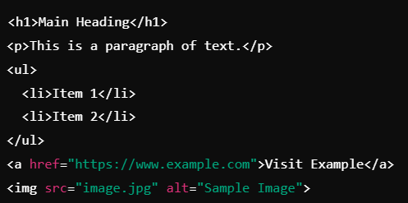

Slide 19
Summary of Key Points
Recap:
HTML provides the structure for a webpage.
Elements consist of tags, content, and attributes.
Semantic HTML improves accessibility and SEO.
Using best practices ensures better usability and inclusivity.

Slide 20
Coding Lab

Slide 21
Introduction to the Coding Lab
Objective: Students will apply HTML concepts by creating their own webpage.
Project Goal: Create a personal webpage with headings, paragraphs, links, and images.
Skills Covered: HTML structure, use of common tags, semantic HTML, and basic accessibility practices.

Slide 22
Setting Up the Development Environment
Step 1: Install and set up a code editor (e.g., VS Code, Sublime Text).
Step 2: Create a folder called html_basics_lab and inside it, create a file named index.html.
Step 3: Open the index.html file in the code editor and start writing HTML.

Slide 23
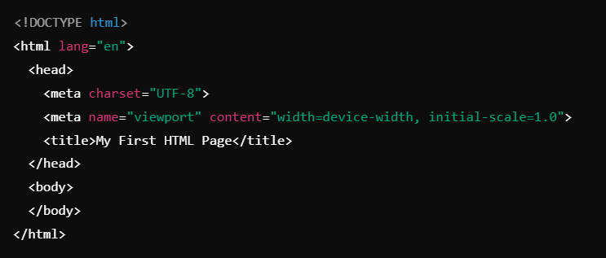
Writing the First Line of Code: Setup

Slide 24

Task: Add a heading and a paragraph to the page.

Slide 25
Task: Add an image using the <img> tag.

Slide 26
Task: Add a link to another website.
Challenge: Make the link open in a new tab using the target="_blank" attribute.

Slide 27
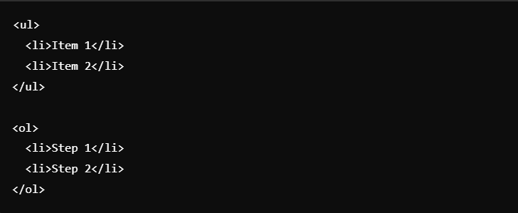
Task: Add an unordered and ordered list.

Slide 28
Debugging and Troubleshooting
Common Issues:
Missing closing tags (e.g., </img>).
Incorrect file paths for images or links.
HTML structure errors (e.g., forgetting to wrap content in the <body>).
Solution: Use browser developer tools (Inspect) to identify errors.

Slide 29
Code Review
Walkthrough: Review the code written so far. Ensure all elements are properly structured.
Best Practices: Emphasize clear, readable code and the use of semantic tags.

Slide 30
Finalizing the Project
Goal: Finalize the webpage with added elements like multiple paragraphs, a list, and at least one image.
Test: Preview the HTML file in a browser.
Challenge: Add a footer with your name and contact information.

Slide 31
Q & A Session

Slide 32
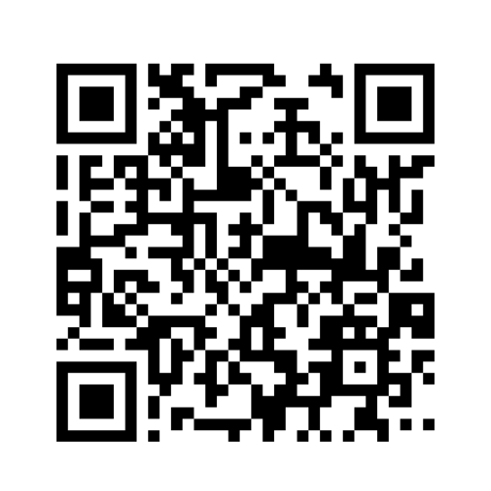
https://github.com/CODE-CRUNCH-CLUB/C8-CRUNCH-LABS-WEB-DEV

Slide 33





Attendance
Join us for the next sessions
Check our schedule on Discord “Schedule” Channel
RSVP lu.ma/CODECRUNCH
Your feedback helps us improve. Share your thoughts! Go to our website: go.fiu.edu/codecrunch
linktr.ee/CODE.CRUNCH

